Slide 1

CIS-4951
With Dr. Bruce Maxim
Drone-Car Collaboration Project
Use Case Presentation
Demetrius Johnson
Ryan Sauer
Olivia Pellegrini
Jonathan Schall

Slide 2

Introduction
IoT (Internet of Things) devices have become very prominent in today's world of connectivity.
Vehicle to Vehicle (V2V) networks have been in development for many years now, and is essential to the development of autonomous vehicles
[refs: 1,2,3,4]
With the rollout of 5G standards and service, Edge Computing becomes a more powerful and feasible option for the doing computing on edge devices rather than relying on the cloud [refs: 1,2,3,4].
Edge computing can reduce latency and reduce network load (improve bandwidth).
So how can we put it all together?
autonomous vehicles + edge computing + V2V networks + battery power = optimization problem.
Notes:
Jonathan

Slide 3
Goals and Objectives
The main objective of our project is to develop a drone-car collaborative model that can be used to obtain data on drone-car collaboration. The model will use a drone camera to record the surroundings of the car and notify the car of potential hazards in real time. Some basic goals of our model are:
Accurately detect a potential hazard in multiple environments using sensors from the car and drone, particularly the vision systems (camera).
Minimize car stop-response-latency by optimizing the communication protocol between the drone and the car.
Maximize drone battery life.
Develop a working product that is open source and reproducible through our documentation to serve as a future reference/baseline for further research.
Notes:
Jonathan

Slide 4
Statement of Scope
Car driving (both driverless and with driver)
Video feed from drone and car
Drone following car
Analyze objects in video feeds (i.e. obstacles, cars, colors of such obstacles and cars)
Send data from drone to car (and vice versa)
Store system analytics on the drone and the car
Notes:
Jonathan

Slide 5
Software and Hardware Context
Raspberry Pi model 4B
https://www.raspberrypi.com/products/raspberry-pi-4-model-b/
Used as the onboard computing device for both the car and the drone (each has their own Raspberry Pi computing device) for autonomous driving/flying by taking input from the sensors and processing the information, and also for communications (networking) with between devices (vehicles), such as wireless communications, i.e. WIFI.
Raspberry Pi Ai Car Kit (PiCar-X) for Intermediate
https://www.sunfounder.com/products/picar-x
https://docs.sunfounder.com/projects/picar-x/en/latest/introduction.html
Used as the physical device for the car including motors, frame, driving mechanism, and sensors.
The Raspberry Pi OS imager should be used to image the sd card that will serve as the nonvolatile memory unit the Raspberry Pi computer of the car:
https://www.raspberrypi.org/software/
Here is the Repository that is cloned onto the Raspbian OS image of the Raspberry Pi; it will contain all of the installation files needed to program and control the car:
https://github.com/sunfounder/robot-hat
Clover Drone 4.2
https://clover.coex.tech/en/
Used as the physical device for the drone including motors, frame, propellers, sensors, Electronic Speed Controllers (ESC), GPS, etc.
Includes Pixracer R15 Mini Pixracer Autopilot Xracer FMU V4 V1.0 PX4 Flight Controller
https://docs.px4.io/main/en/flight_controller/pixracer.html
Notes:
meech

Slide 6
Software and Hardware Context
Python Programming Language
https://www.python.org/
We will use the Python programming language for both the car and the drone.
OpenCV-Python Library
https://pypi.org/project/opencv-python/
This is a Python vision analysis library that has been adapted from a library originally written for C++
We will use it to analyze vision data collected from cameras on both the car and the drone.
Raspbian OS builds with Linux Kernel
https://www.kernel.org/
Both the car and the drone have their own onboard computing device (Raspberry Pi model 4B) with a custom modified version of the Raspbian Operating System image that uses the Linux Kernel.
Additionally, the Clover 4.2 Drone uses the ROS robotic framework used for advanced robotic distributed systems.
https://wiki.ros.org/
Here is the image used for the Clover 4.2 Drone Raspberry Pi computer:
https://github.com/CopterExpress/clover/releases/tag/v0.23
Image features:
Raspbian Buster
ROS Noetic
Configured networking
OpenCV
Mavros
Periphery drivers for ROS (GPIO, LED strip, etc)
Aruco_pose package for marker-assisted navigation
Clover package for autonomous drone control
Notes:
meech

Slide 7
Software and Hardware Context
Q Ground Control
https://docs.qgroundcontrol.com/master/en/
This is an open source software used to communicate with and calibrate and configure a drone’s flight controller firmware. We will use this to calibrate the drone and manage the flight controller’s parameters and how the flight system of the drone uses and responds to sensor data.
Here is the firmware image used for our flight controller:
https://github.com/CopterExpress/Firmware/releases/tag/v1.8.2-clover.13
Clover Drone Simulation virtual machine (VM) image
https://github.com/CopterExpress/clover_vm
This is the virtual machine image used to run the simulation software used to simulate programmed autonomous flights for the Clover 4.2 Drone.
Image contains:
Ubuntu 20.04 Focal.
ROS Noetic.
PX4 autopilot, QGroundControl.
Preinstalled Clover and Clover simulation packages.
Shortcuts for running Clover simulator.
VSCode.
Useful robotics-related software.
Drone Simulation Environment (Using Gazebo software)
The simulation environment is based on the following components: Gazebo, a state-of-the-art robotics simulator;
http://gazebosim.org/
PX4, specifically its SITL (software-in-the-loop) components;
https://px4.io/
sitl_gazebo package containing Gazebo plugins for PX4;
https://github.com/PX4/sitl_gazebo
ROS packages and Gazebo plugins
Note: all of the above components are installed on the Clover Drone Simulation VM in order to do simulation programming without the Raspberry Pi on board computing device of the drone. This allows for programming and simulation without needing the physical drone present.
Etcher - Flashing Software
https://www.balena.io/etcher
This is the software used to flash the micro-SD card with the respective OS (drone or car) used as the nonvolatile memory unit for the Raspberry Pi computers.
Notes:
meech

Slide 8
Major Constraints
The project needs to be completed by August 15th, 2023. This gives us approximately six months to complete the model. However, after the model is finished, we would like to use it to collect research data of our own. In order to do this the model would need to be finished before August.
Currently we are working with the PiCAR-x and the Clover Drone
We will be obtaining a few extra Raspberry-Pi’s in order to give everyone on the team the ability to work with one. Outside of this, there will be a very limited budget and it is unlikely the remaining budget can afford extra drones, cars, or expensive technology.
Additionally, drone flight regulations from University and state policies make finding and developing a more comprehensive test environment more challenging and limited.
Notes:
Ryan

Slide 9
User Profiles and Stories
Vehicle Administrator
Manages vehicle condition
Makes pre-approved adjustments to vehicles parameters
Experiment Facilitator
Carries out experiments
Ensures safe protocols are in place
Alerts vehicle administrator to parameter adjustments
Data Analyst
Controls data collection methods
Retrieves data from vehicles after experiment
Parses data and produces results
Notes:
Ryan

Slide 10
Special Usage Situations
Tests must take place in a controlled environment
In house only data use removes the need for data masking
All parameter changes must be documented thoroughly for continuity
Drone policy on campus is strict and we must be aware of every rule and adhere to them throughout the process
Notes:
Ryan

Slide 11
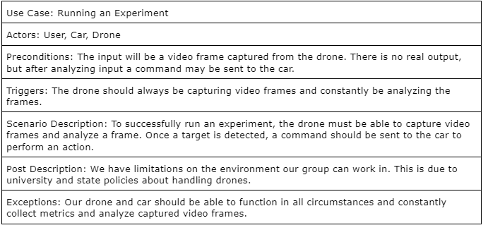
Description for Function n
Notes:
Olivia

Slide 12
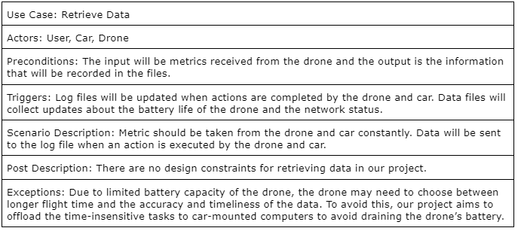
Description for Function n
Notes:
Olivia

Slide 13
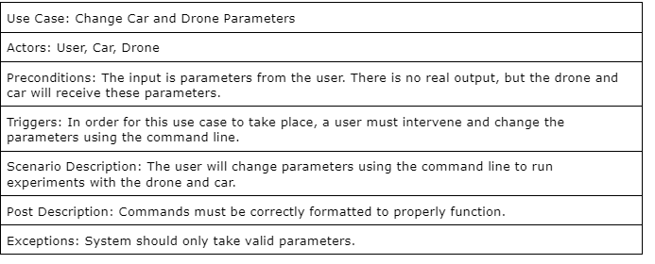
Description for Function n
Notes:
Olivia

Slide 14
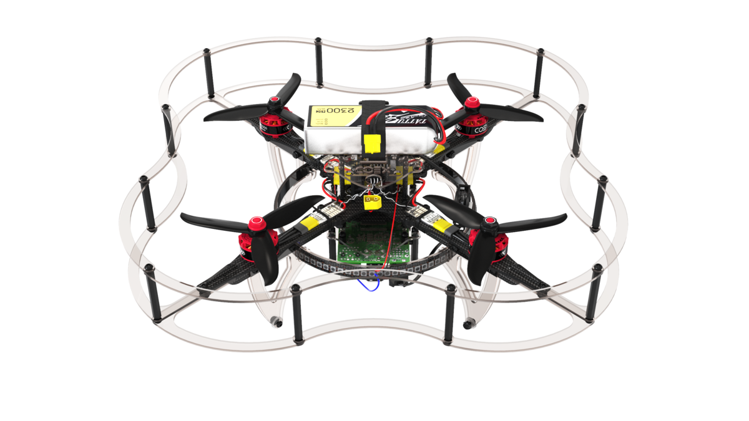


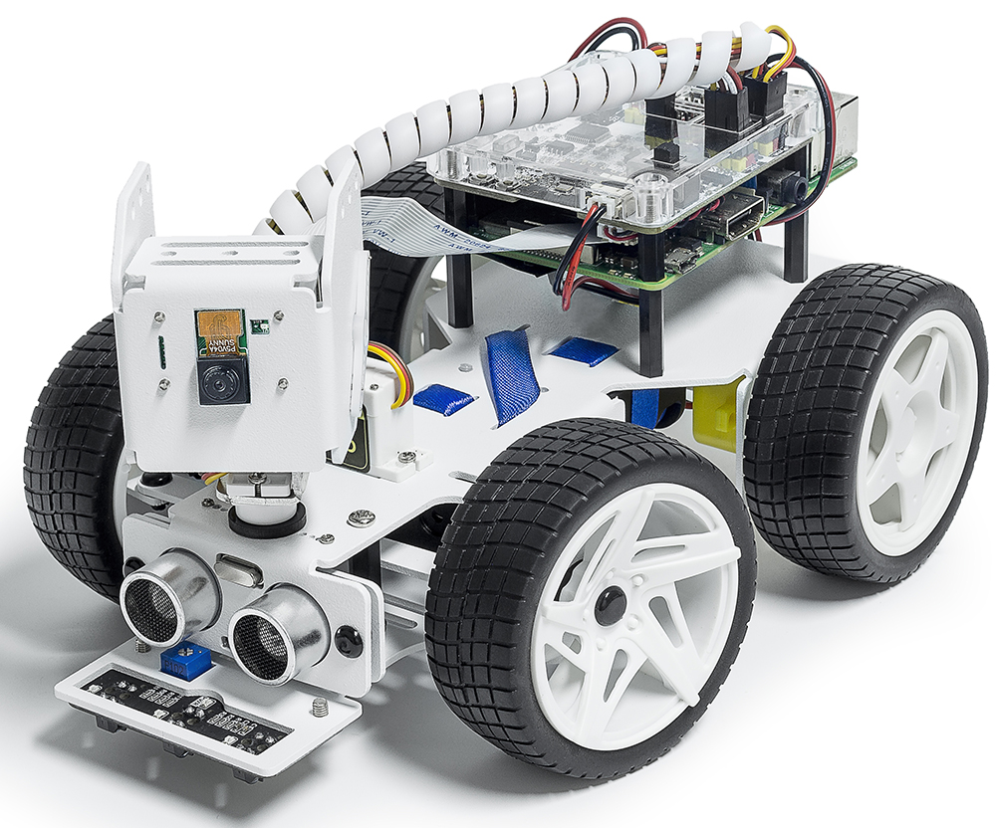

Use Case Diagrams
Actors in our Diagrams:
Clover Drone 4.2
PiCAR-X Car
Our Group Members
Notes:
Olivia

Slide 15
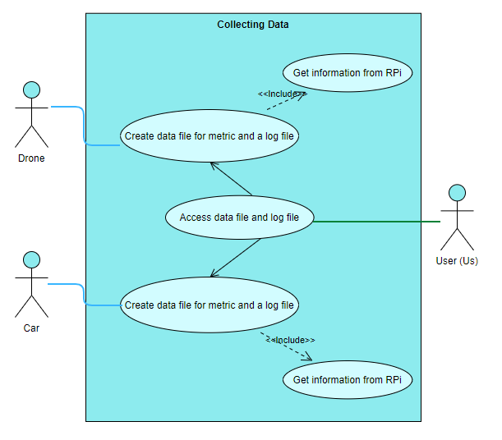
Collecting Data
Data file will include the battery life and network status.
Log file will hold information about the actions completed by the drone and car.
Information is collect from the RPi
Will be measuring latency (time to transfer data) and bandwidth (amount of data transferred) with data that is collected
User accesses the files to observe data
Notes:
Olivia

Slide 16
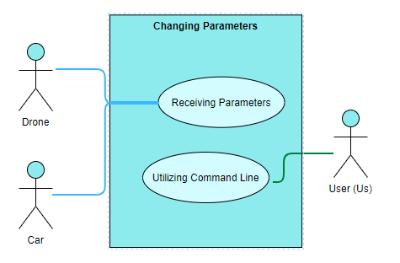
Changing Parameters
User will be able to change parameters using the command line
Allows user to pass input into our program and run an experiment
Drone and car both receive parameters in order to execute experiment
Notes:
Olivia

Slide 17
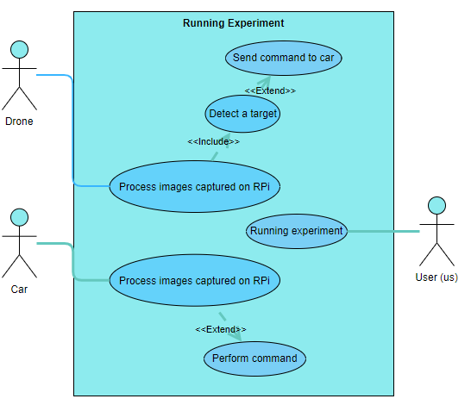
Running Experiments
Drone will capture video frames to be analyzed using OpenCV software
As our first task, we will be using it to detect color in a frame
Should detect a given target
Ex: a red car
Once detected, a command will be sent to the car
Ex: stop if a red car is detected
The command is then executed by the car (PiCARX)
Notes:
Olivia

Slide 18
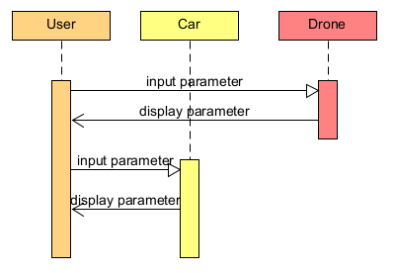
Sequence diagram - Changing Parameters
Notes:
Jonathan

Slide 19
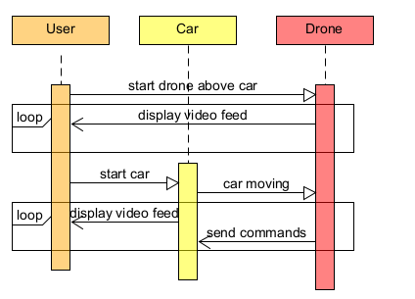
Sequence diagram - Running Experiment
Notes:
Jonathan

Slide 20
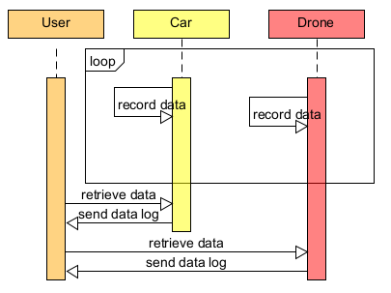
Sequence diagram - Collecting Data
Notes:
Jonathan

Slide 21
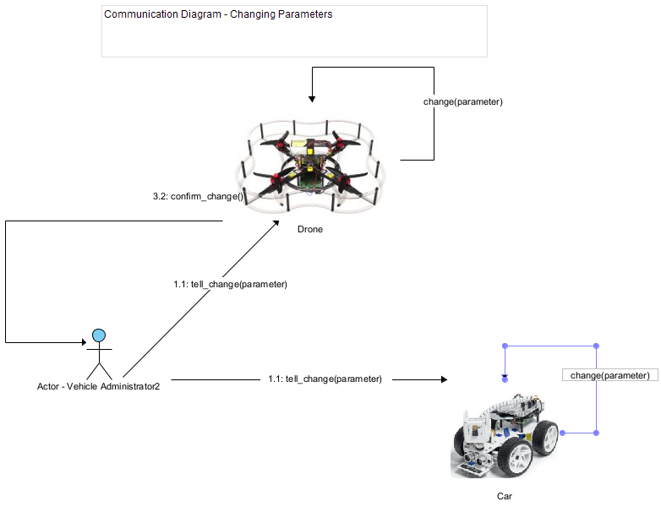
Communication Diagram - Changing Parameters
Notes:
Ryan

Slide 22
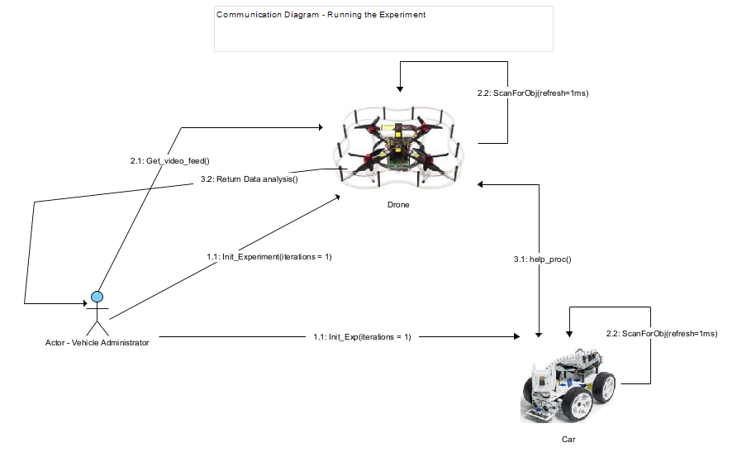
Communication Diagram - Running Experiment
Notes:
Ryan

Slide 23
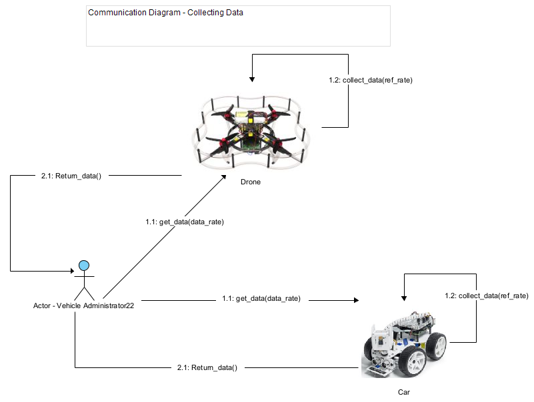
Communication Diagram - Collecting Data
Notes:
Ryan

Slide 24
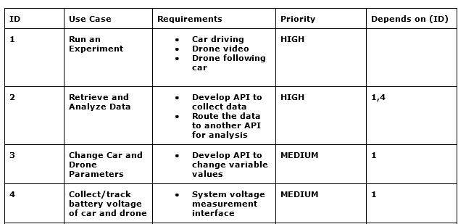
Traceability Matrix
Notes:
Ryan

Slide 25
Project Schedule (backlog + gantt chart)
https://drive.google.com/file/d/1p-FEnmrbFu59l8RjIFJITVISdUhRWvly/view?usp=share_link
Notes:
meech

Slide 26
Contact Us
Demetrius Johnson
meech@umich.edu
Ryan Saur
sauerr@umich.edu
Jonathan Schall
jcschal@umich.edu
Olivia Pellegrini
opelle@umich.edu
Dr. Zheng Song (Client)
zhesong@umich.edu
Dr. Bruce Maxim
Senior Design Professor/Director CIS-4951 Winter 2023
bmaxim@umich.edu

Slide 27
Research References
S. A. Hadiwardoyo, E. Hernández-Orallo, C. T. Calafate, J. -C. Cano and P. Manzoni, "Evaluating UAV-to-Car Communications Performance: Testbed Experiments," 2018 IEEE 32nd International Conference on Advanced Information Networking and Applications (AINA), Krakow, Poland, 2018, pp. 86-92, doi: 10.1109/AINA.2018.00025.
URL: https://ieeexplore.ieee.org/stamp/stamp.jsp?tp=&arnumber=8432227&isnumber=8432202
J. Yoon, I. Kim, W. Chung and D. Kim, "Fast and accurate car detection in drone-view," 2016 IEEE International Conference on Consumer Electronics-Asia (ICCE-Asia), Seoul, Korea (South), 2016, pp. 1-3, doi: 10.1109/ICCE-Asia.2016.7804775.
URL: https://ieeexplore.ieee.org/stamp/stamp.jsp?tp=&arnumber=7804775&isnumber=7804716
Yildiz, Melih, Burcu Bilgiç, Utku Kale, and Dániel Rohács. 2021. "Experimental Investigation of Communication Performance of Drones Used for Autonomous Car Track Tests" Sustainability 13, no. 10: 5602.
URL:
https://doi.org/10.3390/su13105602
Barbeau, Michel, Joaquin Garcia-Alfaro, and Evangelos Kranakis. 2022. "Research Trends in Collaborative Drones" Sensors 22, no. 9: 3321.
URL:
https://doi.org/10.3390/s22093321
Notes:
meech

